Slide 1

Functional Programming in Java 8+ using The Stream API

Slide 2
What is an API?
API is the acronym for Application Programming Interface, which is a software intermediary that allows two applications to talk to each other. Each time you use an app like Facebook, send an instant message on WhatsApp, or check the weather on your phone on Google, you're using an API!

Slide 3
Alright, what is this “Stream”?
The Stream API is one the two most important recent features added to Java (Lambda Expression and Streams).
The Steam API provides sophisticated methods that can search, filter, map, reduce (or otherwise “manipulate”) data. (But hey, don’t worry, they are actually very easy-to-use!)
The Stream API provides a high-level of efficiency when you want to work with a large or a very large data set.

Slide 4
Word of Caution!
The Stream API actually uses some of the most advanced features of Java like Generics, Lambda Expressions, Parallel Execution, and the Collections Framework; so if you ever feel like something is not quite right, or you’re losing it, just take a breather, drink some water, maybe rant about it to your pal, and come back. ;)

Slide 5

So, let us understand what is a “Stream”
Think of a “Stream” like a flow of water in a small river or canal, relaxing right? Now imagine if the river is flowing with data instead of water.
There you have it! This is what “Stream” is! It basically represent a simple sequence of some objects.

Slide 6
A Data Source
A Java Stream works on a Data Source.
This Data Source can be anything,
An array
A List of something, a Set of something or any similar Collection
It can actually be some lines written in a file too! (cool right?)

Slide 7
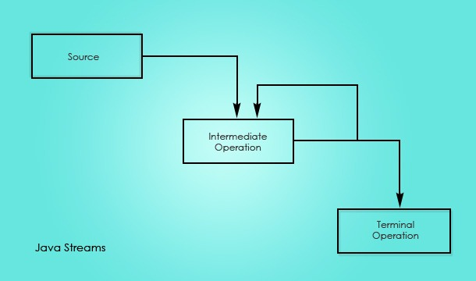

Slide 8
How to create a stream
We can create a stream in 3 ways
Using an object of any class from the Collections Framework
Using any array of the reference data type (primitives can be used with their Wrapper Classes)
Using the Interfaces defined in the `java.util.stream` package.

Slide 9
Using an object as the data source
// Data Source
ArrayList<String> names = new ArrayList<>();
names.add("Sam");
names.add("Dean");
names.add("Robert");
names.add("Castiel");
// Stream using the ArrayList object as the data source
Stream<String> streamOfNames = names.stream();

Slide 10
Using an array as the data source
// Data Source
Integer[] numbers = {1, 2, 3, 4, 5};
// Stream using the array as the data source
Stream<Integer> streamOfNumbers = Arrays.stream(numbers);

Slide 11
Using the predefined Instream Interface
IntStream integerStream;
// Initializing the stream using the range() method
integerStream = IntStream.range(1, 100); // a range from 1 to 99
// OR
integerStream = IntStream.rangeClosed(1, 100); // a range from 1 to 100

Slide 12
Intermediate operations
Intermediate operations are some methods that we can apply on a stream.
There can be any number of intermediate operations on the stream (0 or more)
Intermediate operations do not change the actual values of the stream, rather they create a separate stream.
Ex - filter()

Slide 13
Intermediate Operations - filter()
The filter() method is used to filter out some values from the stream.
You can define a lambda expression as the argument to this method, or you can pass in a method reference.

Slide 14
Example of intermediate operation [filter() method]
// Data Source
Integer[] numbers = {1, 24, 39, 6, 82, 55, 41, 13, 78, 55};
// Stream
Stream<Integer> streamOfIntegers = Arrays.stream(numbers);
// filter all the even numbers [only select the even numbers and create a separate stream
Stream<Integer> evenNumbersStream =
streamOfIntegers.filter(number -> number % 2 == 0);
Notice the use of a lambda expression as an argument to the filter() method here

Slide 15
There are two types of arguments to an intermediate operation
Either you can pass a “method reference” of a method that you want to call on the elements of the stream.
General Syntax - ClassName::methodName
Ex - System.out::println
Or if you do not have any method that fits your use case, you can simply create a “method-on-the-go” by creating a lambda expression, as we had seen in the previous example.

Slide 16
Terminal Operations
Terminal operations are some methods that we can apply on a stream that will cause the stream to be “consumed” or “closed”.
ONCE A STREAM IS “CONSUMED” or “CLOSED” IT CANNOT BE REUSED.
Some terminal operations often collapse the stream into a single retrievable value after processing.
Ex - min(), max(), count()
Some terminal operations can be used to iterate on the elements of the stream Ex - forEach(), noneMatch()

Slide 17
Terminal Operations Example - forEach()
// Data Source
Integer[] numbers = {1, 24, 39, 6, 82, 55, 41, 13, 78, 55};
// Stream
Stream<Integer> streamOfIntegers = Arrays.stream(numbers);
Stream<Integer> evenNumbersStream =
streamOfIntegers.filter(number -> number % 2 == 0);
evenNumbersStream.forEach(System.out::println);
This prints all the elements of the stream on the console, you can pass a lambda also number -> System.out.println(number + “ “)

Slide 18
You can read more about the Java Stream API here
https://howtodoinjava.com/java8/java-streams-by-examples/

Slide 19
THANK YOU!

